Slide 1
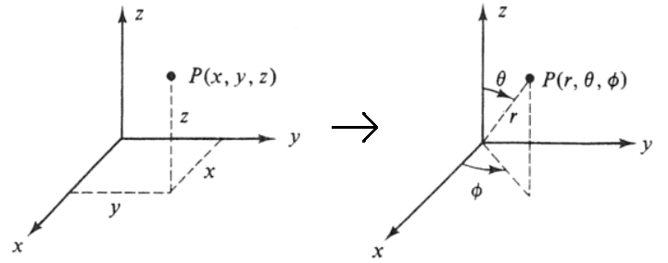
Cartesian & Polar Coordinate
Cartesian Coordinate System
Polar Coordinate System
x = r sinθ cos ø
y = r sinθ sin ø
z = r cos θ
r² = x² + y² + z²
Θ = 0 to 180°
Ø = 0 to 360°

Slide 2
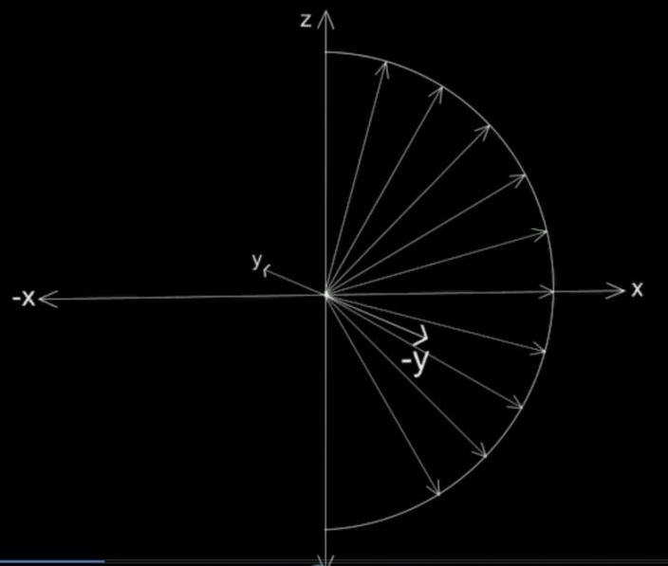
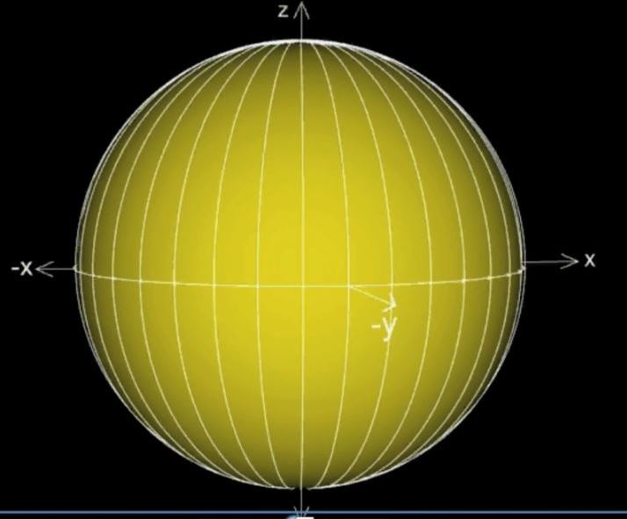
Polar Coordinate

Slide 3
Polar Plot of cosθ

Slide 4
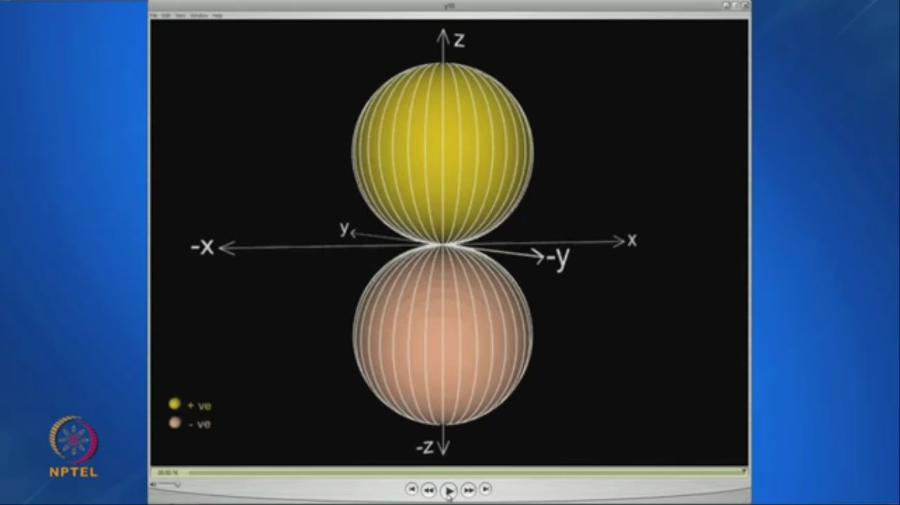
Pz Orbital

Slide 6
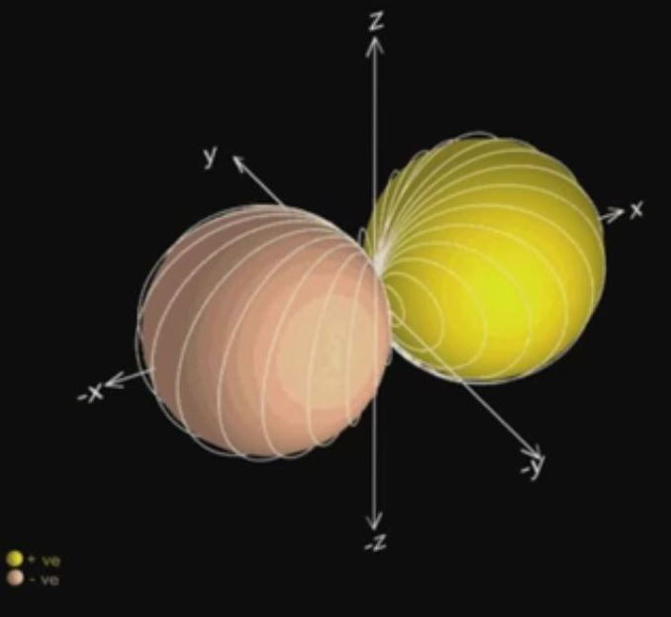
Px Orbital

Slide 7
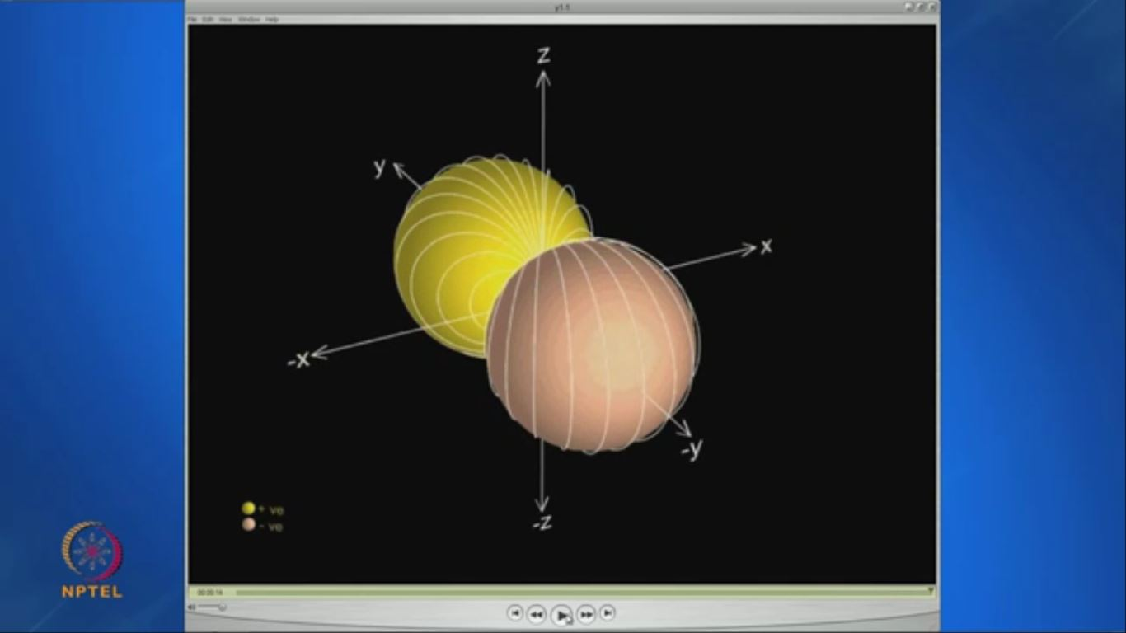
Py Orbital

Slide 8
Polar Plot of ( 3cos²θ-1)

Slide 9
d_{z}² Orbital

Slide 11
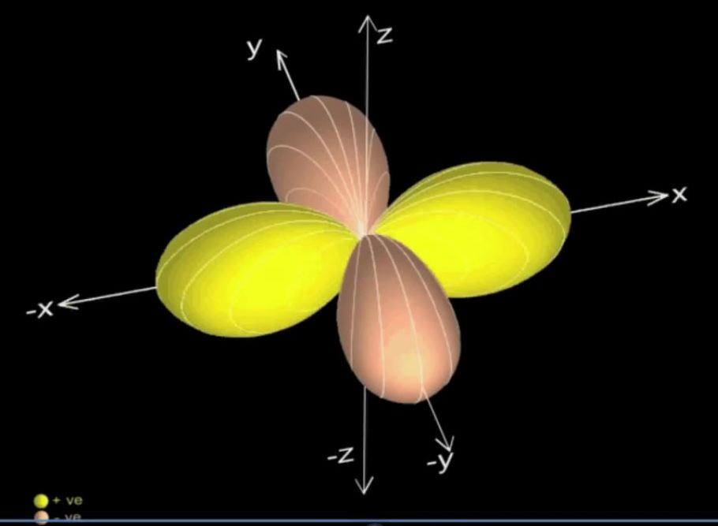

Slide 12
